Slide 1
Bike Rental Trends and Insight
Prepared for : [Nexthike Solution]
Prepared by : [Barkha Jaiswal]

Slide 2
Project Objective
To analyze bike rental data.
Present key trends in ride bookings by date, month and weather situation.
Track bike rental by Date(each hour of day).
Compare ride counts depend on temperature, humidity and wind speed.
Compare ride counts across days and months.
Identify unusually high or low rental days.

Slide 3
Key Performance Indicator
Total Rides: 58304
Rides booked by Registered Users: 53383
Rides booked by Casual Users: 4921
Average Rides: 58.3%
Peak Hour recorded on 22 Jan 2011: 8 AM
Registered Rides Share: 92%
Casual Rides Share: 8%

Slide 4
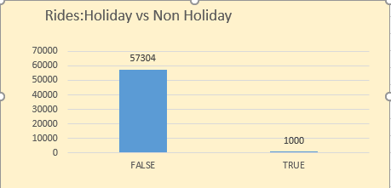
Holiday vs Non Holiday
This bar chart shows rides booked on holiday and non holiday.
Rides booked on holiday: 1000
Rides booked on non holiday:57304

Slide 5
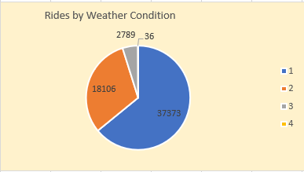
Rides by Weather Condition
The pie chart shows rides booking depends on weather situation where 1 represents Normal weather, 2 represents Cloudy, 3 represents Rainy and 4 represents Thunderstorm.
Rides booked on Normal days:37373
Rides booked on Cloudy days:18106
Rides booked on Rainy days:2789
Rides booked on Thunderstorm:36

Slide 6
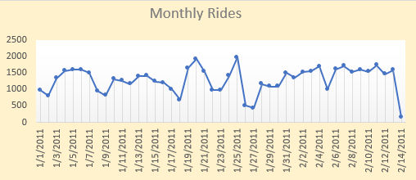
Monthly Rides
This line chart represents rides booked on each day of month from 1 Jan 2011 -14 Feb 2011

Slide 7
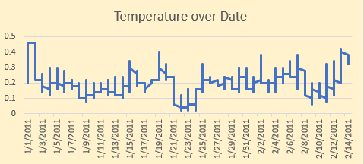
Temperature over Date
. The chart shows temperature changing across the dates from January to February 2011.
.Temperatures fluctuate, with a noticeable dip in late January.
.They rise again in February, with some warmer peaks near the end of the period.

Slide 8
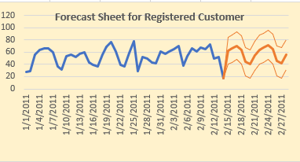
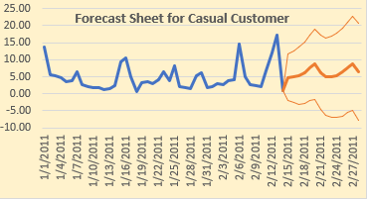
Forecast Sheet for Registered and Casual Customer
These two forecast sheet show :
. Historic rides counts fluctuate, with a few noticeable peaks.
. The forecast suggests rides may generally increase over the next several days, through the range is wide.
. The shaded band shows forecast uncertainty, so treat the projection as an estimate.

Slide 9
Thank You
We appreciate the opportunity to present our Bike Rental Dashboard project

